Slide 1

Analysis of Stock Trends impacted by pandemic viruses
Team Members: Grace Ming, Lucy Wo, Belinda Liang, Jaeeun Lee, Lawson Xie, Andrew Li
Date: March 18, 2020

Slide 2

Agenda
Background of SARs and COVID-19
Hypothesis
Exploration and Cleaning data
Deep analysis SARs data
Summary

Slide 3

Analysis
Data Cleaning and Reformatting:
Sources : SARs Data and Stock Market Data (S&P 500 Index and others)
How :
Merging data from different sources
Removing unnecessary columns
Grouping data, setting index, rename columns
Analyse:
Number of countries are infected
Total number of people infected, death, recovered
Stock Market：
Focus on the S&P 500 to represent the stock market performance during SARs
Comparing stock performance before and after SARs

Slide 4
Timeline - SARs outbreak
March 2003 (Peak)
July 2003
Mar 12, 2003
WHO announced global alert
Mar 28, 2003
More widespread worldwidely
WHO dismissed global alert on SARs

Slide 5
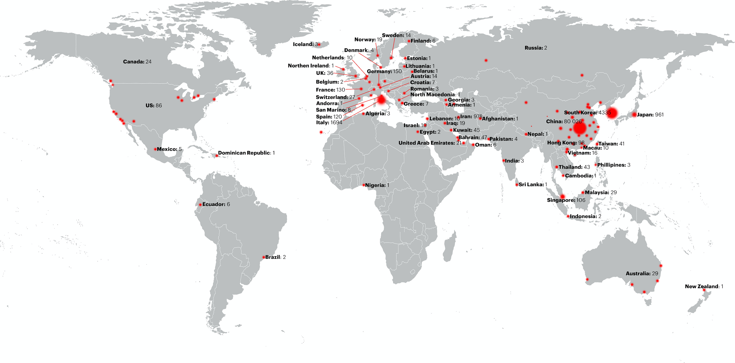
SARs - Relative Information
Date Range: 2003/03/17 to 2003/07/11: 75 days
Total number of countries: 37
Total number of people infected: 8645
Which day has the max number of ppl infect: 26-Mar (836)
Which day has the least: 19-Apr, beginning of July (0)
Ave number of people are infected in the whole period:87 ppl/day

Slide 6
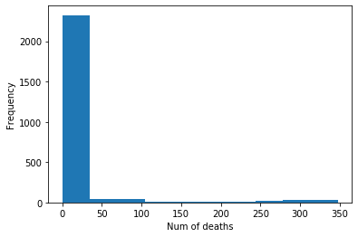
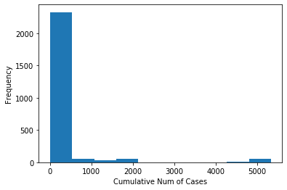
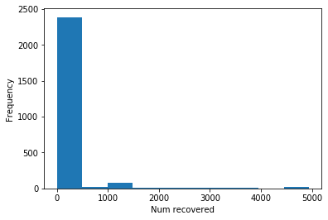
Analysis of Key Metrics of SARs Cases

Slide 7
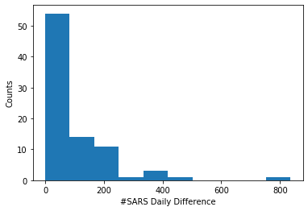
Deep Analysis SARs Daily Difference
The mean SARs daily difference is 97.62
The median SARs daily difference is 63.0
The mode SARs daily difference is 63.0
Normal test result (pvalue=1.0419301191553956e-13)
The population variance of SARs daily difference is 15247.59944636678
The population standard deviation SARs daily difference is 123.48

Slide 8
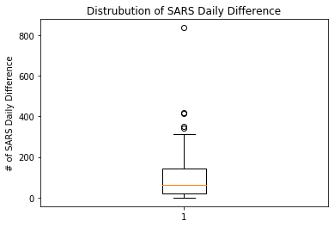
Outlier of Num of SARs Daily Difference
The lower quartile of SARs daily difference is: 19
The upper quartile of SARs daily difference is: 144
The interquartile range of SARs daily difference is: 125
The the median of SARs daily difference is: 63
Values above 331.5 could be outliers

Slide 9
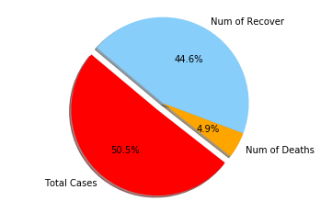
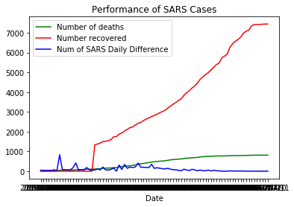
Distribution and Performance of SARs data

Slide 10
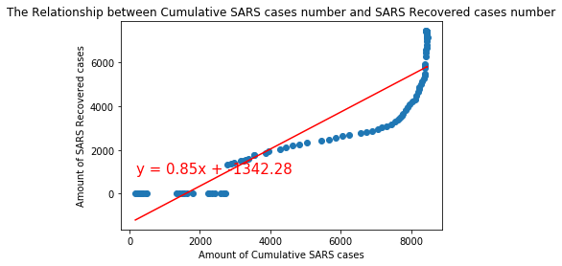
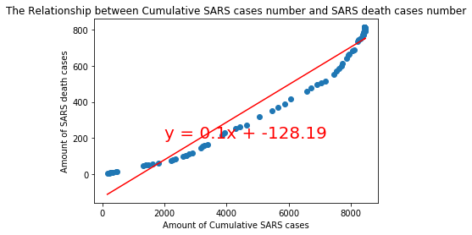
Linear Regression Analysis of SARs Cases

Slide 11
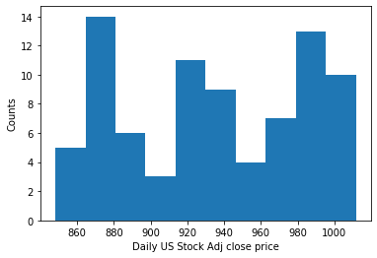
Deep Daily US Stock Adj Close Price
The mean Daily US Stock Adj close price is 934.3973165609756
The median Daily US Stock Adj close price is 932.544983
The mode Daily US Stock Adj close price is 932.5 NormaltestResult( pvalue=2.2e-08)
The population variance of Daily US Stock Adj close price is 2360.1
The population standard deviation Daily US Stock Adj close price is 48.6

Slide 12
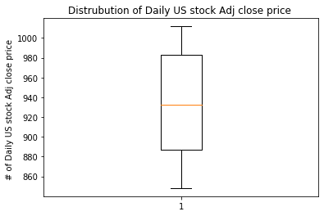
Outlier of Daily US Stock Adj Close Price
The lower quartile of Daily US stock Adj close price is: 886.6
The upper quartile of Daily US stock Adj close price is: 983.2
The interquartile range of Daily US stock Adj close price is: 96.5
The the median of Daily US stock Adj close price is: 932.5
Values below 741.8 could be outliers
Values above 1128.0 could be outliers

Slide 13
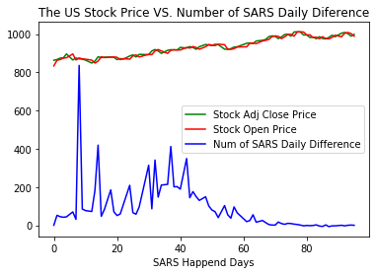
The US Stock Price VS. Number of SARs Daily Difference

Slide 14
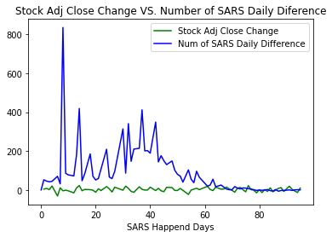
Stock Adj Close Change VS. Number of SARs Daily Difference

Slide 15
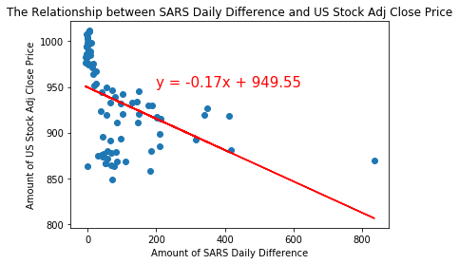
The Relationship between SARs Daily Difference and US Stock Adj Close Price

Slide 16
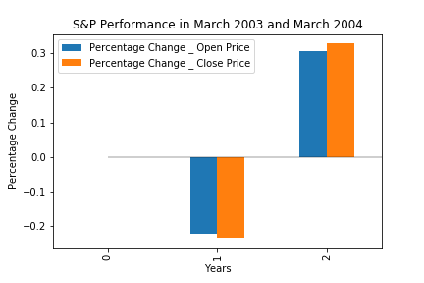
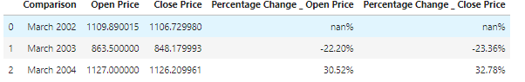
Percentage Changes - SARs Reached Peak and A Year After
March 2003 (Peak):
Open and Close Price:
Drops 22.2% and 23.36% compares to the March 2002
March 2004 :
Recovered
About 10 percent above March 2002

Slide 17
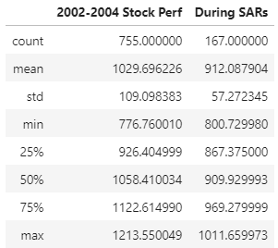
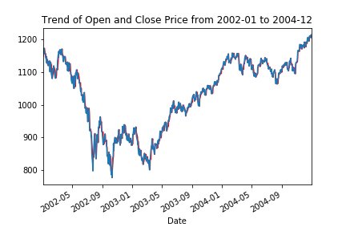
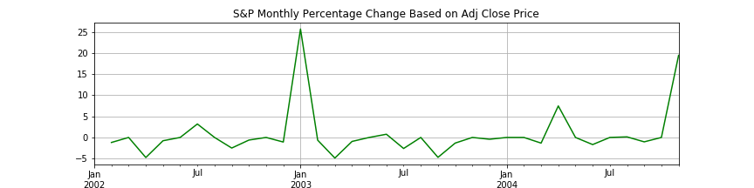
Would SARs a big impact on stock market?
Close Price : During SARs vs 2002 Jan to Dec 2004
Mean & Min price During SARs, not reached at the lowest number
Lowest point: End of 2002, not on March 2003 when SARs reached peak
Monthly Percentage Change graph: Largest percentage changed on Jan 2003, not on March 2003

Slide 18
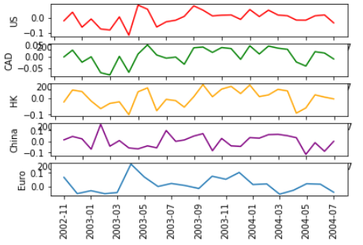
More Indexes: Percentage Change on Monthly Closing Price
US: S&P 500
CAD : S&P/TSX
HK: Heng Seng Index
China: Shenzhen Index - did not impact as much as US, CAD, HK China
Europ: Euro Stoxx 50
- Increased

Slide 19
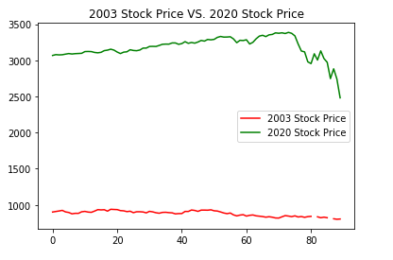
2003 Stock Market vs 2020 Stock Market
The 2020 stock market crash began on February 20.The S&P 500 finished down nearly 12% by March 16, its worst day since 1987
The drop was caused by unbridled global fears about the spread of the coronavirus
In 2003, the stock market were still at a lower level following the tech bubble and not coming off a decade-long bull market
The SARs outbreak was not the only main reason. Another major international factor as the U.S. invaded Iraq in March also impacted the stock

Slide 20
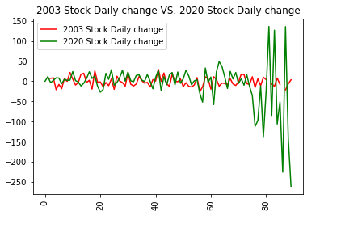
2003 Stock Market vs 2020 Stock Market
The SARs outbreak contributed to a slump in US markets in early 2003, but stocks recovered once the outbreak was contained
The S&P 500 dropped roughly 10% from the start of the year until mid-March, but finished up more than 26% for the 2003 whole year
Black Monday, March 09, 2020 -7% drop
Black Thursday, March 12, 2020, -9% drop
March 16, 2020, a new record -12% drop

Slide 21
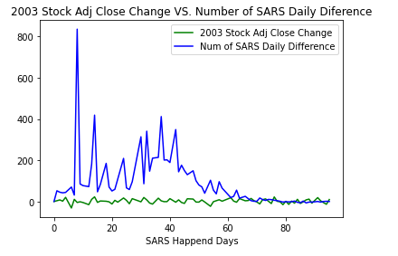
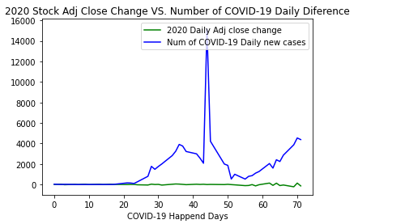
Markets ‘powered through’ SARs, but the coronavirus outbreak is different

Slide 22
Conclusion-SARs
The Market’s reactions to Coronavirus is not the same as SARs
SARs: US stock market was not impacted much by the outbreak of disease
SARs showed impact on S&P but it was not significance in the 3 years trend
Main Reasons:
Outbreak mainly shown up in Asia
Much less contagious and high recovery rate
No big impact on industry
Other international factor as the U.S. invaded Iraq

Slide 23

Conclusion-COVID-19
COVID-19: stock market went down dramatically as outbreak increased
Much higher number of outbreak shown up globally (SARs: 8k vs COVID-19 208k)
COVID-19 is spreading more quickly
Social/internet panic and hype because more contagious, lower mortality rate
A number of suppliers over the world shut down during the outbreak

Slide 24
Thank you!

